Slide 1
PyTorch公开课
BUSINESS
2019
JULYEDU
北京七月在线科技有限公司
褚则伟 zeweichu@gmail.com
https://www.julyedu.com/

Slide 2

CONTENTS
01
深度学习模型入门
02
用PyTorch构建深度学习模型
03
PyTorch精彩项目介绍
推荐系统实战课程
julyedu.com

Slide 3
深度学习模型入门
01
Supporting text here.
When you copy & paste, choose "keep text only" option.

Slide 4
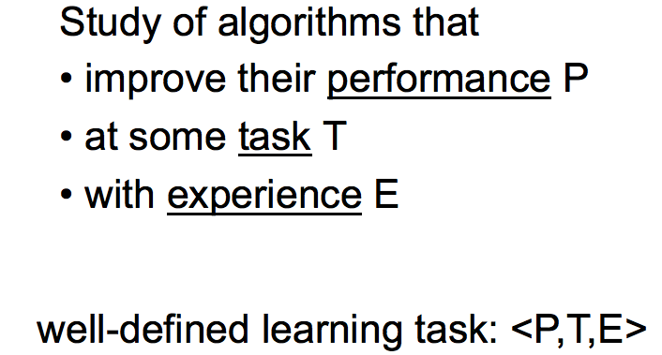
什么是机器学习？
来自Tom M. Mitchell Machine Learning Course

Slide 5
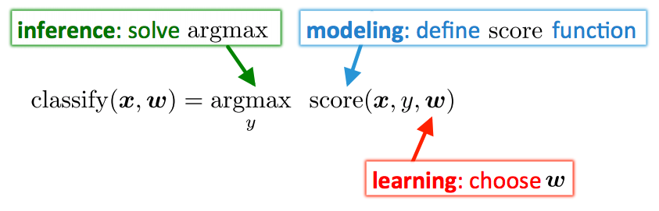
Modeling, Inference, Learning

Slide 6
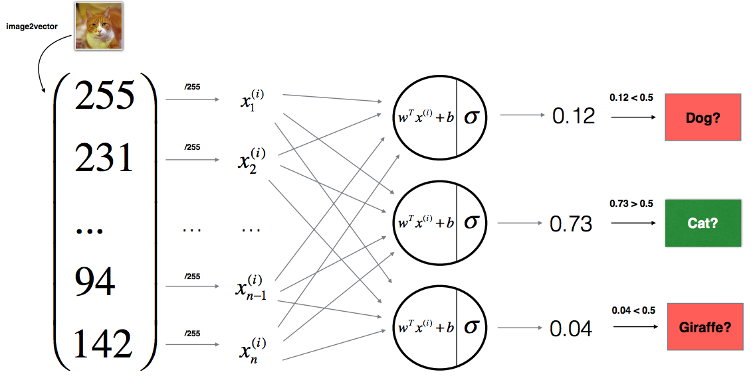
什么是深度学习？

Slide 7
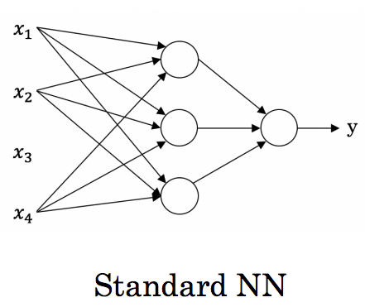
前向神经网络

Slide 8
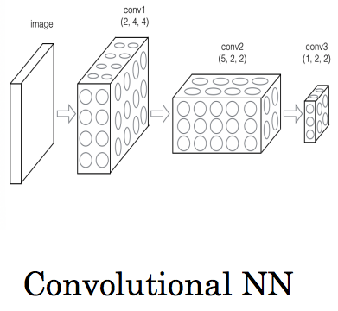
Convolutional NN

Slide 9
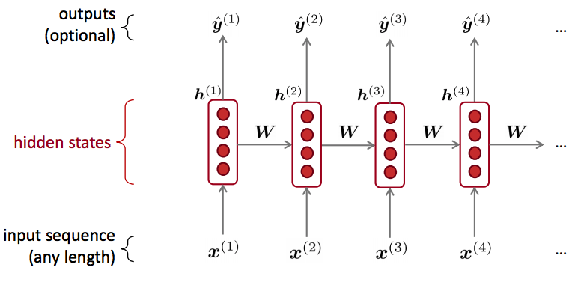
Recurrent Neural Networks

Slide 10
用PyTorch构建深度学习模型
02
Supporting text here.
When you copy & paste, choose "keep text only" option.

Slide 11






深度学习模型框架概览
Caffe

Slide 12
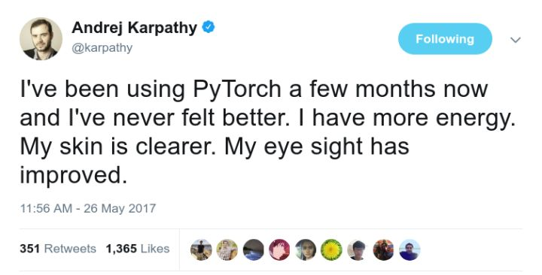
PyTorch与其他框架的对比
PyTorch: 动态计算图 Dynamic Computation Graph
Tensorflow: 静态计算图 Static Computation Graph
PyTorch代码通俗易懂，非常接近Python原生代码，不会让人感觉是完全在学习一门新的语言。
拥有Facebook支持，社区活跃

Slide 13
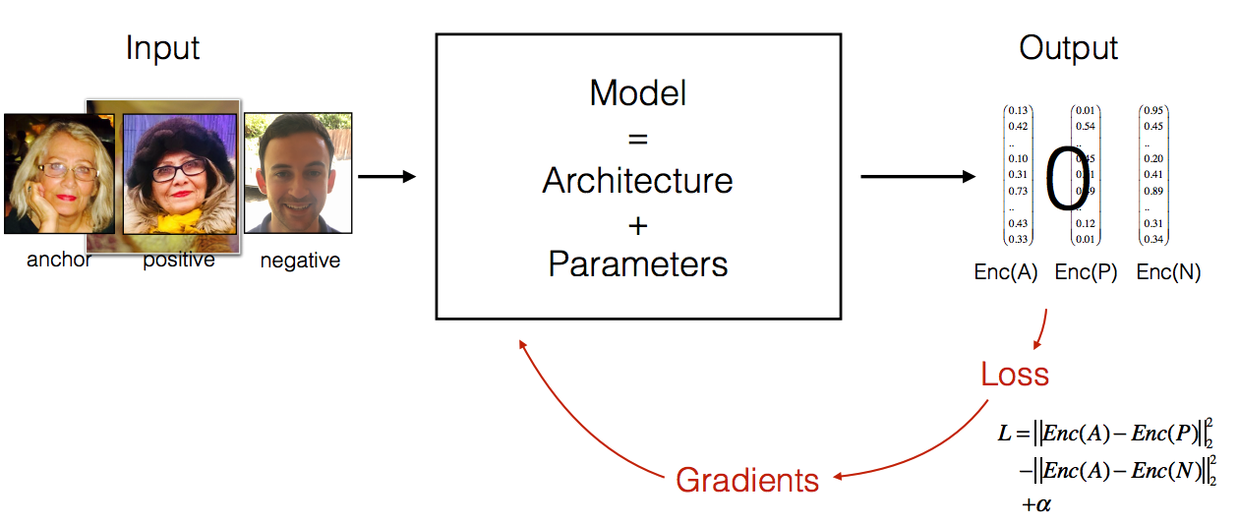
PyTorch可以做什么？

Slide 14
PyTorch精彩项目介绍
03
Supporting text here.
When you copy & paste, choose "keep text only" option.

Slide 15
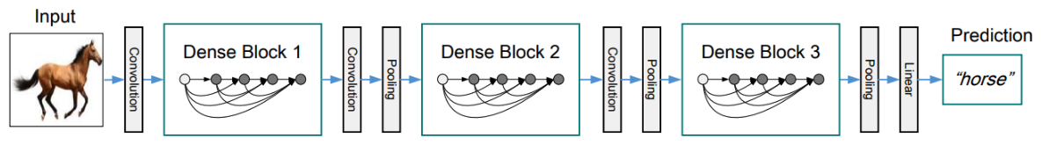
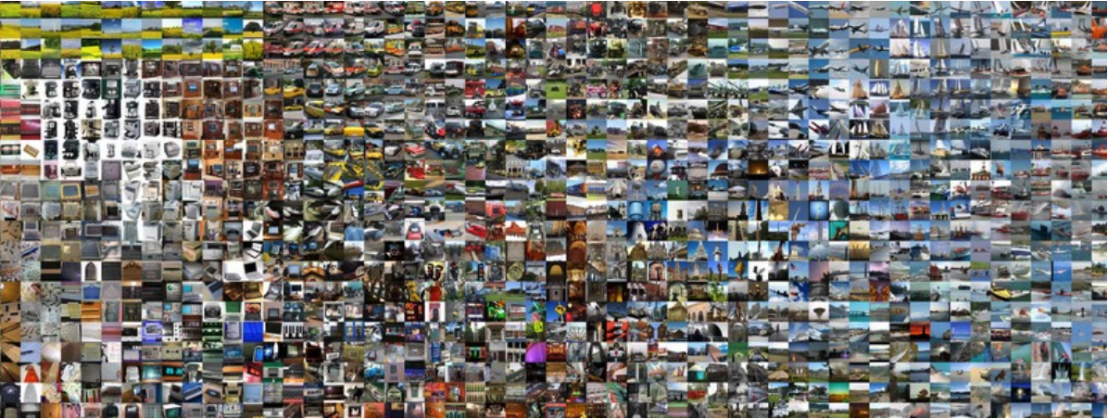
图像分类
https://github.com/floydhub/imagenet

Slide 16
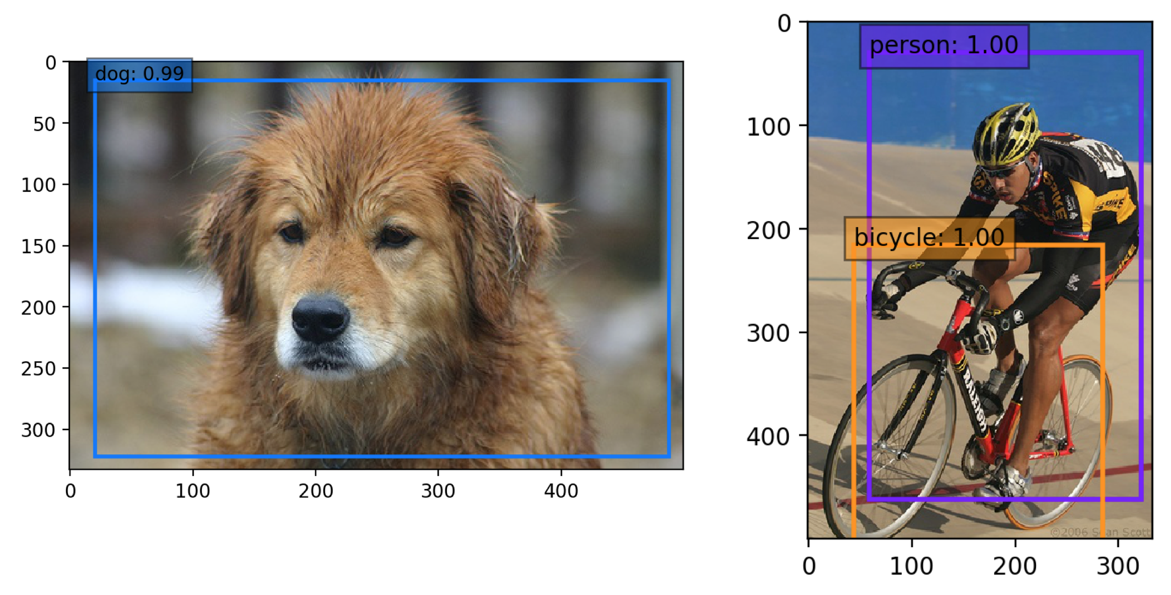
Object Detection
https://github.com/amdegroot/ssd.pytorch

Slide 17
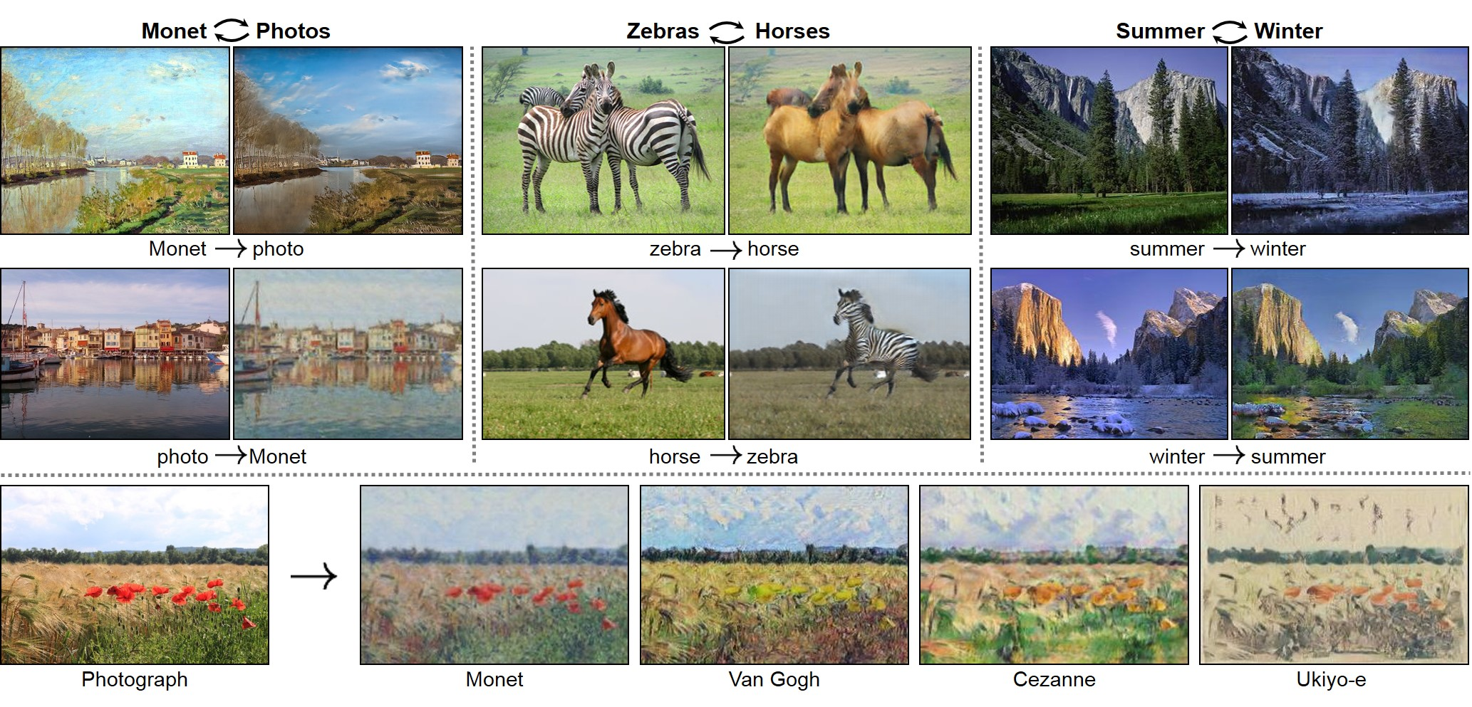
CycleGAN
https://github.com/junyanz/pytorch-CycleGAN-and-pix2pix

Slide 18
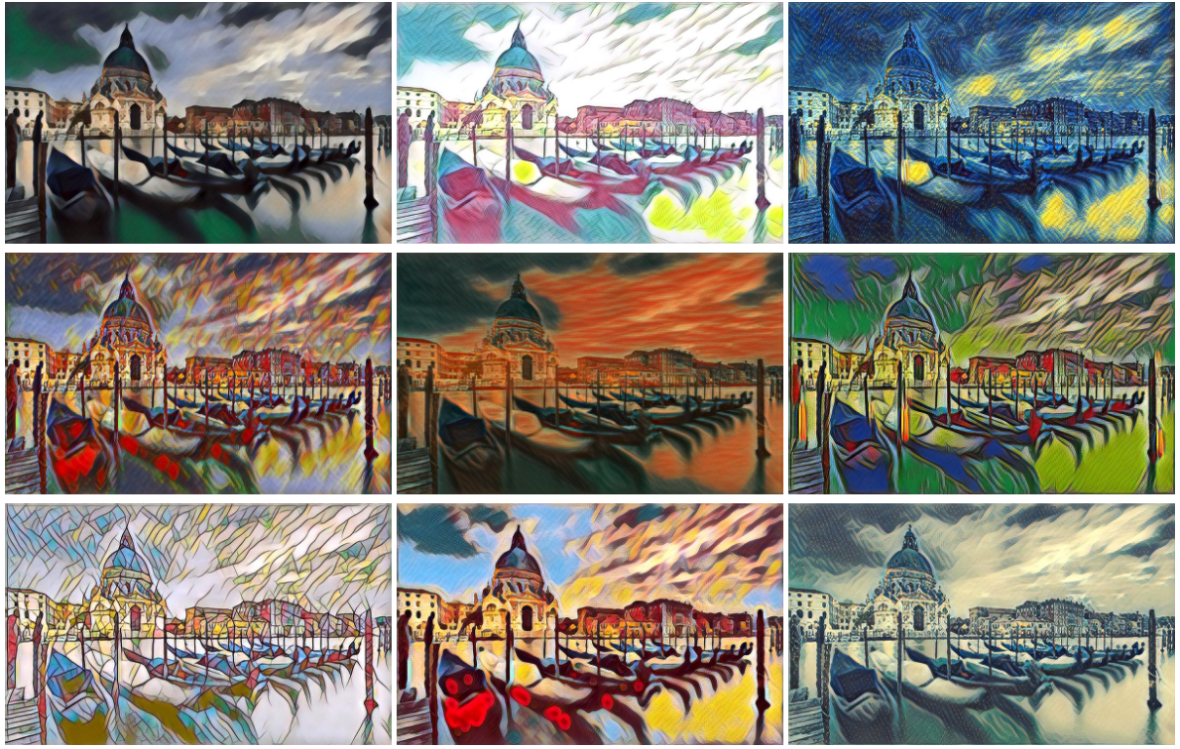
Image Style Transfer
https://github.com/zhanghang1989/PyTorch-Multi-Style-Transfer

Slide 19
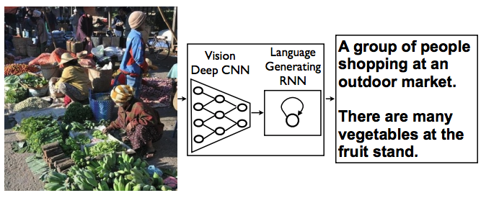
Image Captioning
https://github.com/ruotianluo/ImageCaptioning.pytorch

Slide 20
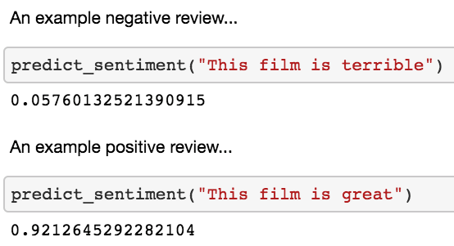
情感分析
https://github.com/bentrevett/pytorch-sentiment-analysis

Slide 21
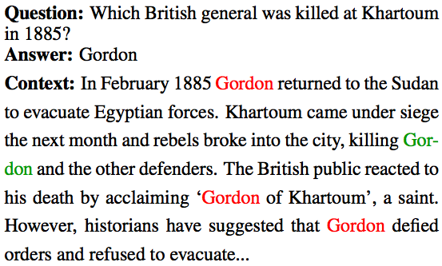
Question Answering
https://github.com/allenai/document-qa

Slide 22
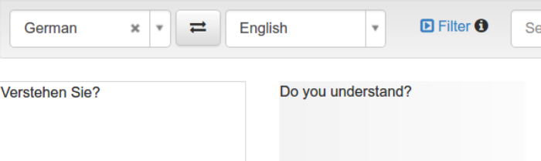
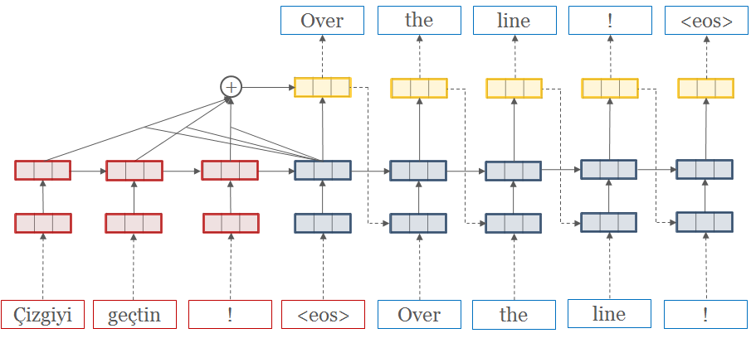
Translation: OpenNMT-py
https://github.com/OpenNMT/OpenNMT-py

Slide 23
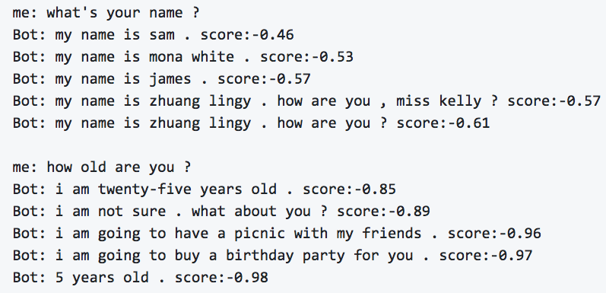
ChatBot
https://github.com/czs0x55aa/pytorch-chatbot

Slide 24
Deep Reinforcement Learning
https://github.com/jingweiz/pytorch-rl
https://pytorch.org/tutorials/intermediate/reinforcement_q_learning.html

Slide 25
微信扫一扫关注我们
褚则伟 zeweichu@gmail.com
https://www.julyedu.com/

